Slide 1

Talent Retention Study
Lei Jiang

Slide 2
Objectives
Identify the top features that contribute to employee retention.
Identify job role specific trends.
Build classification models to predict employee turnover using existing data.
Notes:
NEED TO CHANGE slide 4, 7
Hi Dr S, I am very glad to present my findings in the Talent Retention Study, that we used existing employee data from your company to predict employee turnover. We also identified the top features that contribute to employee retention, and job role specific trends so that can be transferred to actionable items that you can refer to when making decisions for the company.

Slide 3
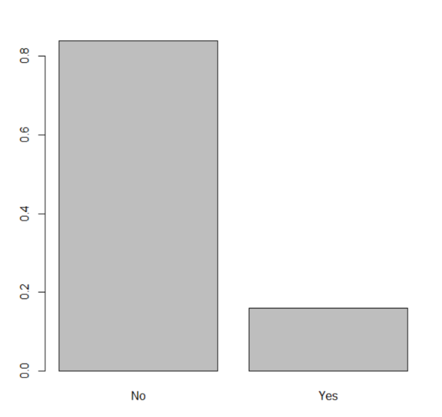
Exploratory data analysis
Training data set: Dimensions of (1170,37)
9 factors, 27 integers, 1 random number
no missing value
Validation data set: Dimensions of (300,37)
9 factors, 27 integers, 1 random number
no missing value
Outcome: ‘Attrition’
Features for use (32 after excluding ID and constant variables Over18, EmployeeCount, & StandardHours ):
'Age', 'DailyRate', 'DistanceFromHome', 'Education', 'EmployeeNumber', 'EnvironmentSatisfaction', 'HourlyRate', 'JobInvolvement', 'JobLevel', 'JobSatisfaction', 'MonthlyIncome', 'MonthlyRate', 'NumCompaniesWorked', 'PercentSalaryHike', 'PerformanceRating', 'RelationshipSatisfaction', 'StockOptionLevel', 'TotalWorkingYears', 'TrainingTimesLastYear', 'WorkLifeBalance', 'YearsAtCompany', 'YearsInCurrentRole', 'YearsSinceLastPromotion', 'YearsWithCurrManager', 'Rand', 'BusinessTravel', 'Department', 'EducationField', 'Gender', 'JobRole', 'MaritalStatus', 'OverTime'
Imbalanced Data – Attrition in Training data set
Notes:
Training data set has the dimension of…Validation data set has the dimension of…and they both have 9 factors, 27 integers, 1 random number and no missing value.
Imbalance –tune paramenters
Over18 , EmployeeCount, StandardHours is constant and should be ignored for analysis
(opposite of ‘Retention’)
Notice that the outcome we used in this study is ‘Attrition’. It is opposite of ‘Retention’. Which means if a feature is positive related with Attrition, it is negatively related to Retention.

Slide 4
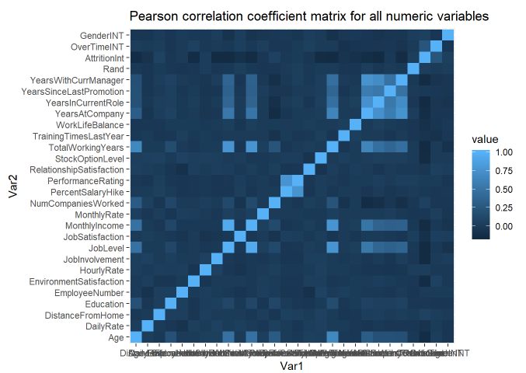
Feature selection - Pearson correlation coefficient matrix
 | AttritionInt | attri_abs
AttritionInt | 1 | 1
OverTimeINT | 0.24 | 0.24
JobInvolvement | -0.15 | 0.15
JobLevel | -0.15 | 0.15
TotalWorkingYears | -0.15 | 0.15
YearsInCurrentRole | -0.15 | 0.15
MonthlyIncome | -0.14 | 0.14
StockOptionLevel | -0.14 | 0.14
YearsWithCurrManager | -0.14 | 0.14
Age | -0.13 | 0.13
EnvironmentSatisfaction | -0.13 | 0.13
YearsAtCompany | -0.12 | 0.12
JobSatisfaction | -0.09 | 0.09
WorkLifeBalance | -0.09 | 0.09
DailyRate | -0.07 | 0.07
DistanceFromHome | 0.07 | 0.07
NumCompaniesWorked | 0.06 | 0.06
TrainingTimesLastYear | -0.06 | 0.06
GenderINT | 0.05 | 0.05
RelationshipSatisfaction | -0.04 | 0.04
Rand | 0.03 | 0.03
Education | -0.02 | 0.02
HourlyRate | 0.02 | 0.02
MonthlyRate | -0.02 | 0.02
PercentSalaryHike | -0.01 | 0.01
PerformanceRating | 0.01 | 0.01
YearsSinceLastPromotion | -0.01 | 0.01
EmployeeNumber | 0 | 0
Top Features (from high to low):
OverTimeINT
JobInvolvement
JobLevel
TotalWorkingYears
YearsInCurrentRole
MonthlyIncome
StockOptionLevel
YearsWithCurrManager
Age
EnvironmentSatisfaction
YearsAtCompany
JobSatisfaction
WorkLifeBalance
DailyRate
DistanceFromHome

Slide 5
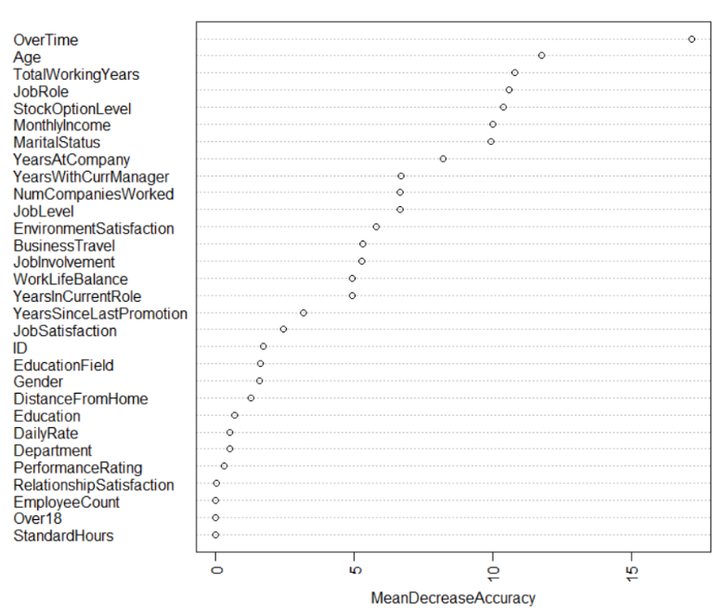
Feature selection Feature importance plot - Random Forest
Top Features (from high to low):
OverTime
Age
TotalWorkingYears
JobRole
StockOptionLevel
MonthlyIncome
MaritalStatus YearsAtCompany
EnvironmentSatifaction
Highly correlated variables: keep one, exclude others.
Notes:
Important features will result in large mean decrease accuracy. In this way/ by doing this we identified the importance of the features. Pretty similar to the previous method.
Age and TotalWorkingYears are highly correlated by Pearson correlation matrix.
More important the feature is, the larger mean decrease in accuracy will be.
The top features are OverTime, Age, TotalWorkingYears, JobRole, StockOption, MonthlyIncome. Also identified MaritalStatus ,YearsAtCompany, and EnvironmentSati to be quite important.
JobRole was identified as more important in this model, compare with JobRole (0.06)

Slide 6
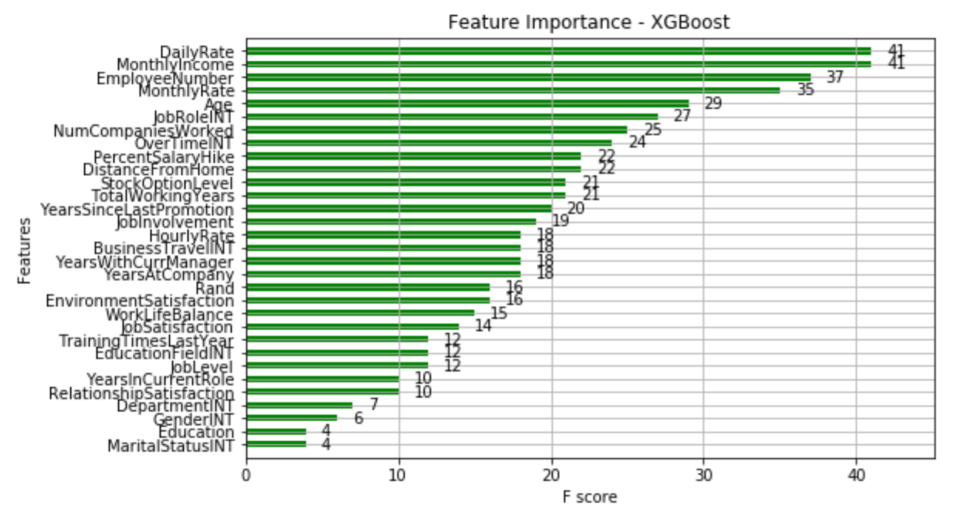
Feature selection - XGBoost
Top Features (from high to low):
DailyRate
MonthlyIncome
MonthylyRate
Age
JobRole
Overtime DistanceFromHome
StockOptionLevel
TotalWorkingYears
Notes:
eXtreme Gradient Boosting
The top features are different from the previous two methods. As DailyRate and EmployeeNumber were identified to be top features.
MonthlyIncome, Age, JobRole, Overtime, DistanceFromHome, StockOptions; difference is DailyRate and EmployeeNumber were also identified to be top factors. And Overtime is less important inthis model.

Slide 7
Top Features - summarized results from three methods
Random Forest
OverTime
Age JobRole
StockOptionLevel
MonthlyIncome
MaritalStatus YearsAtCompany
EnvironmentSatifaction
YearsAtCompany
EnvironmentSatisfaction
Correlation
Matrix
OverTimeINT
JobInvolvement
JobLevel
TotalWorkingYears
YearsInCurrentRole
MonthlyIncome StockOptionLevel
YearsWithCurrManager Age
EnvironmentSatisfaction
YearsAtCompany JobSatisfaction
WorkLifeBalance DailyRate DistanceFromHome
JobRole
OverTime
StockOptionLevel
MonthlyIncome
Age
XGBoost
DailyRate
MonthlyIncome
MonthylyRate
Age
JobRole
Overtime DistanceFromHome
StockOptionLevel
TotalWorkingYears
DistanceFromHome

Slide 8
Job role specific trends
JobRole : Factor w/ 9 levels
1: Healthcare Representative
2: Human Resources
3: Laboratory Technician
4: Manager
5: Manufacturing Director
6: Research Director
7: Research Scientist
8: Sales Executive
9: Sales Representative
Notes:
After that we explored the…First we checked the Attrition rate by job role.
Lab Techs have the highest attrition rate. And research directors have the lowest.
d like to take a look of the attrition rate in each job role.
The result is Lab Techs have the highest attrition rate. And research directors have the lowest.
Here is a figure showing the percentages of each jobrole in the compnay.

Slide 9
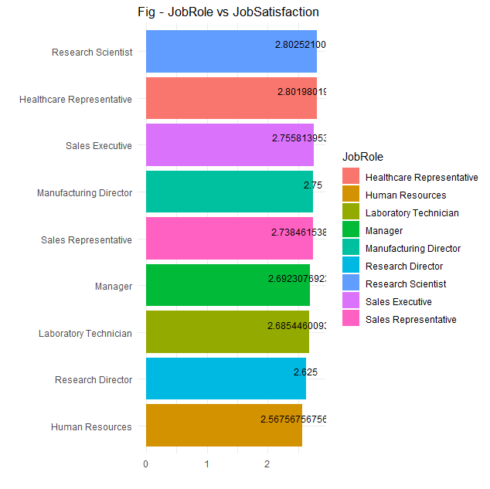
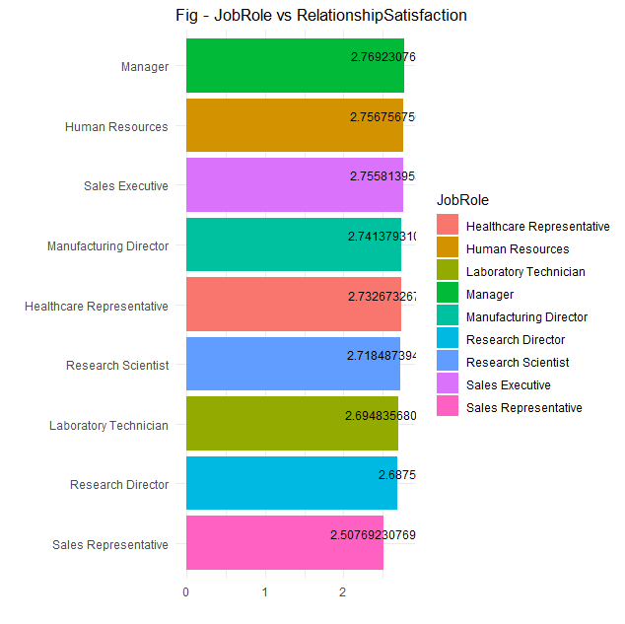
Job role specific trends
Notes:
SALES-读音 lg纠正 For most of the features, Larger number means better.
On average, Research Scientists have the highest job satisfaction; while the Human Resources have the lowest job satisfaction.
Managers have the highest relationshiop satisfaction; while the Sales Representatives have the lowest relationship satisfaction.
Calculated the means of features by job role, and order them in descending order. By doing this we found
For most of the features the higher value means better
In order to explore the trends, we got the means of features by job role, and order them from high to low.
As you can see from the result,
Jobrole trend interpretation
compare means of most correlated features based on different JobRole
JobSatisfaction, RelationshipSatisfaction, WorkLifeBalance, Education, JobInvolvement, PerformanceRating and EnvironmentSatisfaction (8 features)

Slide 10
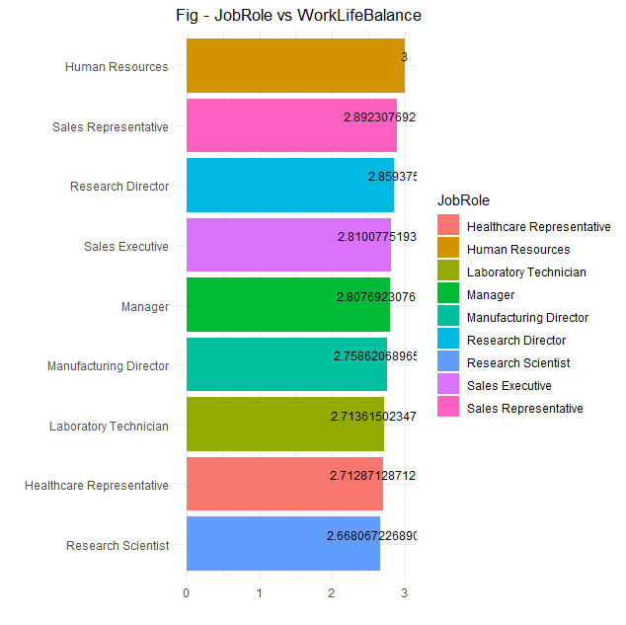
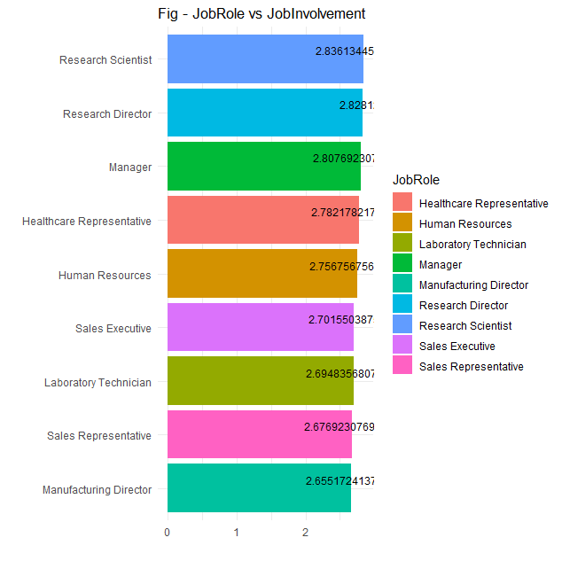
Job role specific trends
Notes:
Human Resources have the highest work life balance; while the Research Scientist have the lowest.
Research Scientists have the highest job involvement; while the Manufacturing Director have the lowest.

Slide 11
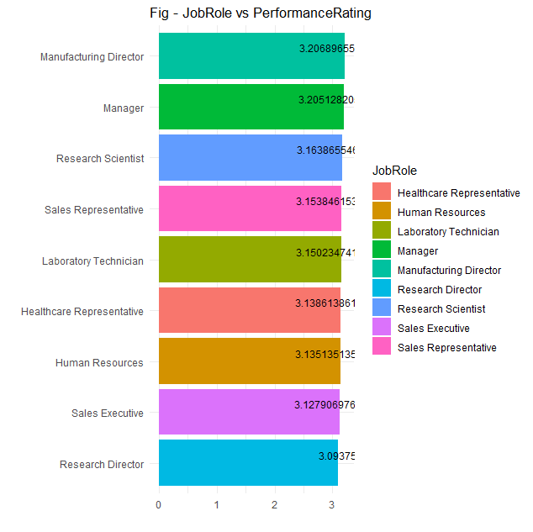
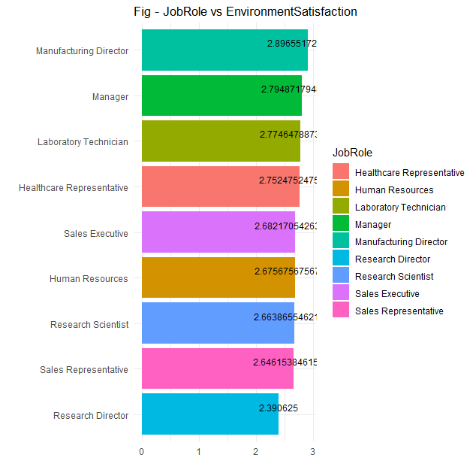
Job role specific trends
Notes:
For PR AND JE, we found MD has highest mean values, and RDs have the lowest values for both of them .
That’s also the case for environment satisfaction. As for the performance rating, Manufacturing Director have the highest performance rating; while the Research Director have the lowest.
Manufacturing Director also have the highest environment satisfaction; while the Research Director have the lowest.

Slide 12
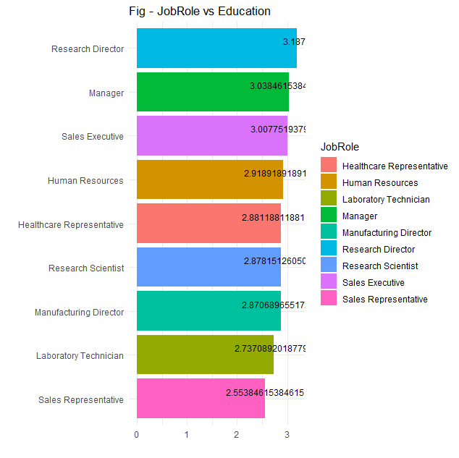
Job role specific trends
Education (Levels: 1 'Below College', 2 'College', 3 'Bachelor', 4 'Master', 5 'Doctor').
Notes:
Research director tend to have the highest education level on average.
The last one,
Department vs jobrole interprets differently.
.are higher, the better, except for department and education.
for all these features, except for Education (Levels: 1 'Below College', 2 'College', 3 'Bachelor', 4 'Master', 5 'Doctor') and Department (Levels:1 Human Resources, 2 Research & Development, 3 Sales).
Interpretation for Department levels
The first two job roles, Sales related job only distributed in Sales. Many job roles only distributed in R&D. Manager are distributed in all Department.
On average, Research Directors have the highest Education level; while the Sales Representatives have the lowest Education level.

Slide 13
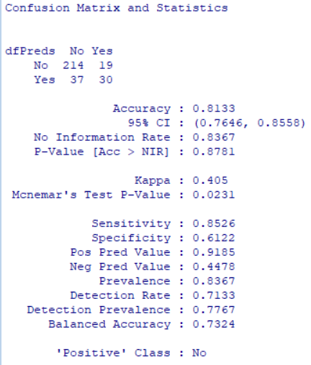
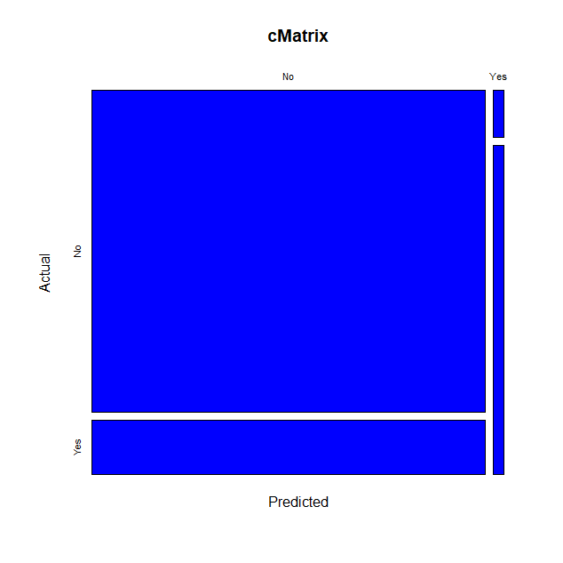
Naive Bayes
Notes:
Next, We built models to predict attrition

Slide 14
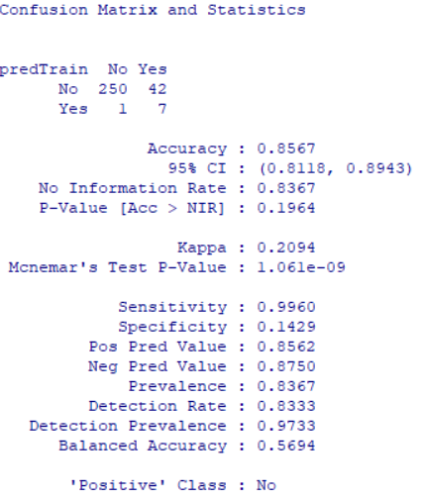
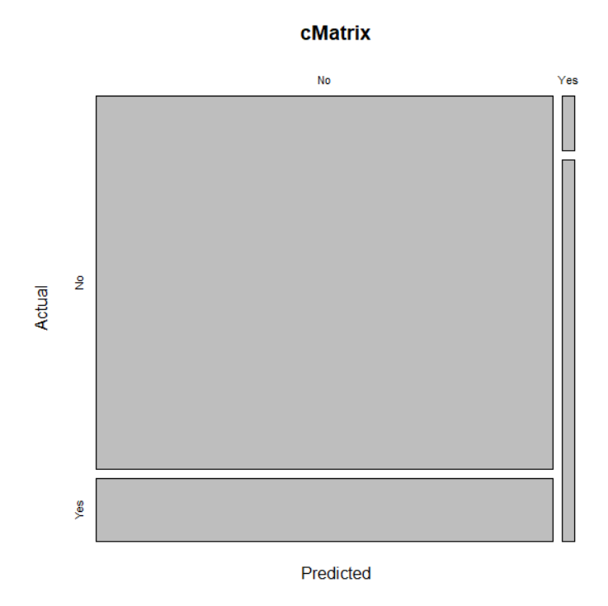
Random Forest

Slide 15
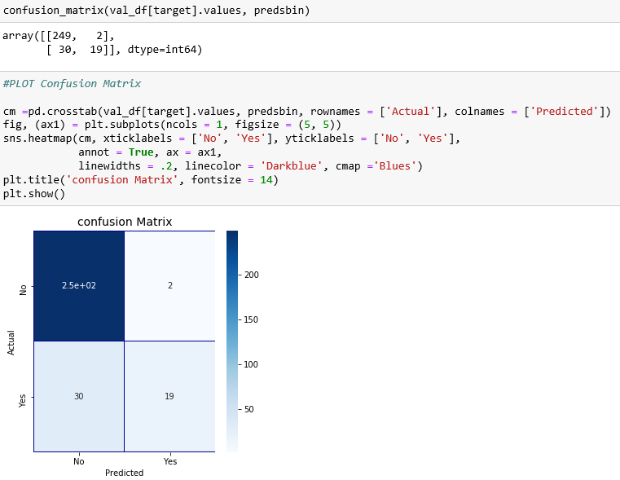
XGBoost Accuracy： 89.33%

Slide 16
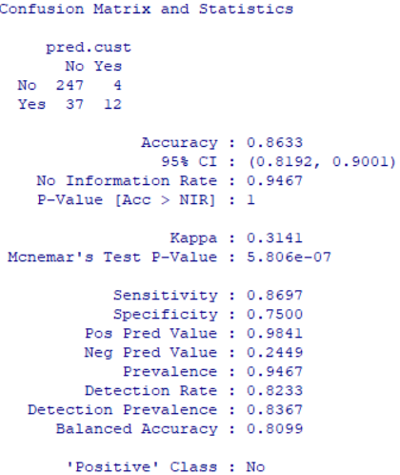
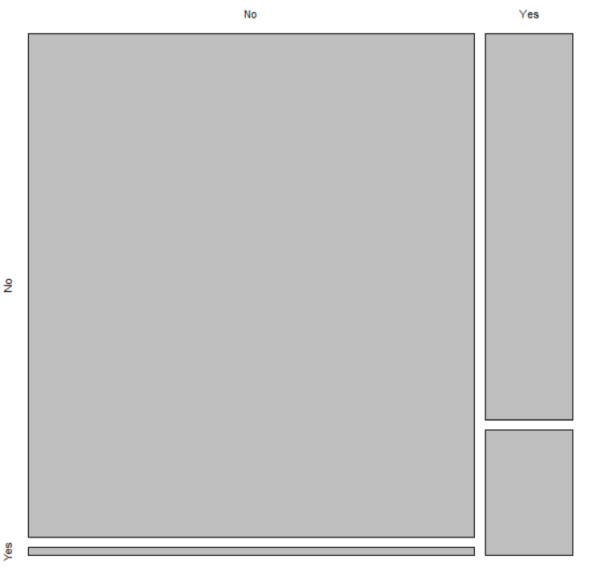
Custom model - Logistic Regression
Attrition~OverTime +MaritalStatus +JobInvolvement + YearsInCurrentRole+ MonthlyIncome+StockOptionLevel+Age + EnvironmentSatisfaction + WorkLifeBalance + JobSatisfaction + Department + DistanceFromHome + JobRole + TrainingTimesLastYear + NumCompaniesWorked
Notes:
Predictors selected from previous result.

Slide 17
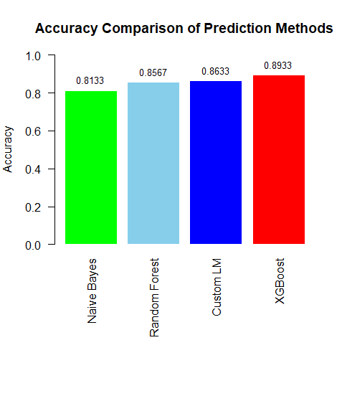
Comparison of classification models
Notes:
We have a comparison of all the models, as we can see xgboost has the highest accuracy.

Slide 18
Conclusions
Identified the top factors that contribute to turnover:
OverTime
StockOptionLevel
MonthlyIncome
Identified interesting job role specific trends, on average:
Research Directors have the highest Education level; while the Sales Representatives have the lowest Education level.
Research Scientists have the highest job satisfaction; while the Human Resources have the lowest job satisfaction.
Managers have the highest relationship satisfaction; while the Sales Representatives have the lowest relationship satisfaction.
Human Resources have the highest work life balance; while the Research Scientist have the lowest.
Research Scientists have the highest job involvement; while the Manufacturing Director have the lowest.
Manufacturing Director have the highest performance rating; while the Research Director have the lowest.
Manufacturing Director also have the highest environment satisfaction; while the Research Director have the lowest.
Notes:
These are also actionable items the company can work on to improve their employees retention.
An interesting finding is Research Scientist lowest work life balance, but highest job satisfaction. On the contrast, Human Resources have the highest work life balance but the lowest job satisfaction. Further exploratory analysis may be needed to understand the reason.
why that may be.
In addition, JobRole, JobInvolvement, and EnvironmentSatisfaction are pretty important features for retention.
satisfaction.

Slide 19
Conclusions
Built models to predict attrition, and compared their accuracies, summarized here:
Naive Bayes 81.33% Accuracy
Random Forest: 85.67% Accuracy
Custom model: 86.33% Accuracy
XGBoost: 89.33 % Accuracy

Slide 20
THANK YOU !

